Slide 1

RTK Query
Redux Toolkit Query “From zero to hero”
Ivanciu Alexandru - Ivi
May, 2023

Slide 2

05
| May, 2023
What is
Redux?
How it
works?

Slide 3

05
| May, 2023
What is Redux Toolkit?
The Redux Toolkit package is intended to be the standard way to write Redux logic.

Slide 4
05
| May, 2023
Redux Toolkit APIs
configureStore
createReducer
createAction
createSlice
createAsyncThunk
createEntityAdapter
The createSelector utility from the Reselect library, re-exported for ease of use.

Slide 5
05
| May, 2023
What is RTK query?
a powerful data fetching and caching tool.
an optional addon included in the Redux Toolkit package
RTK Query functionality is built on top of the other APIs in Redux Toolkit.

Slide 6
05
| May, 2023
Why RTK query?
Tracking loading state in order to show UI spinners
Avoiding duplicate requests for the same data
Optimistic updates to make the UI feel faster
Managing cache lifetimes as the user interacts with the UI

Slide 7
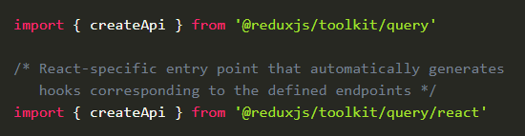
05
| May, 2023
RTK Query APIs
createApi
fetchBaseQuery
<ApiProvider />
setupListeners

Slide 8
05
| May, 2023
Ok… to much documentation
Let’s start coding
BE - I’ve created a JSON file and start a server using json-server
FE - npx create-react-app my-app --template redux-typescript (Redux + TypeScript template)

Slide 9
05
| May, 2023
Q & A

Slide 10
05
| May, 2023
Q & A
My questions / curiosities

Slide 11
05
| May, 2023
I like React, but what about Angular?
ngrx-rtk-query is a plugin to make RTK Query (including auto-generated hooks) works in Angular applications with NgRx!! Mix the power of RTK Query + NgRx + RxJS to achieve the same functionality as in the RTK Query guide with hooks.

Slide 12
Thank You!
May, 2 0 2 3

